Slide 1
The Future Of Remote Communication In .NET
Helping Machines Communicate With Each Other

Slide 2
Why Isn't WCF Supported In .NET Core?
WCF is not supported in .NET Core since it's a Windows specific technology and .NET Core is supposed to be cross-platform.
WCF has in part been undermined by the rising popularity of REST. The programming model in WCF is geared around operations rather than resources
Microsoft’s response to REST is ASP.Net WebAPI
Growing popularity of gRPC as an alternative means of contract-first development which allows you to define genuinely cross-platform operations and models that are tolerant to change. Microsoft included a gRPC template in .Net Core 3.0 implying it as a preferred technology for contract-first development.
28 October 2018
https://www.ben-morris.com/why-isnt-wcf-supported-in-net-core/

Slide 3
WCF Port for .NET Core
A .Net Core port of WCF (CoreWCF) has been accepted into the .Net Foundation (organization started by Microsoft to support open-source dev of .NET Framework)
CoreWCF started in June 2019. The initial version will allow creating HTTP and TCP SOAP services to be created on top of the .Net Core Kestrel server. Although these appear to be the most popular use case for WCF, it is not clear how easy it will be to port existing services to the .Net Core version.
Part of the problem is with the “W” in WCF, i.e. "Windows". Much of the work of porting WCF to a cross-platform paradigm will involve re-implementing operation system libraries, particularly in areas such as socket layers and cryptography. These are the areas of WCF that are never likely to make it through a .Net Core port.

Slide 4
CoreWCF 0.1.0 GA Release
Released Feb 19, 2021
Major Contributors (10,000+ lines of code): @mconnew (Microsoft) @birojnayak (Amazon AWS)
[Microsoft] only wants one service host in .NET Core (not the WCF ServiceHost class)
WCF prototype on top of ASP.NET Core
CoreWCF project caught the attention of the Amazon AWS team and they have been contributing significantly to help make this project a success
Supportability and maintainability is a high priority for CoreWCF.
Removing Asynchronous Programming Model (APM) and removing direct native system calls and IO code.
CoreWCF now uses async/await Task based asynchronous programming throughout. CoreWCF also switched to a request push pipeline model adopting the ASP.NET Core middleware pattern.
CoreWCF doesn’t even know what a Socket is and yet supports NetTcp. ASP.NET Core handles all of that for CoreWCF. It just reads and writes to pipes or streams.
Feb 19, 2021 • Matt Connew
https://corewcf.github.io/blog/2021/02/19/corewcf-ga-release

Slide 5
CoreWCF Road Map
Depends on ASP.NET Core 2.1
This enables still running on .NET Framework through the porting process
The major version being 0 is a reflection of some core features not currently available which would enable justification of a 1.0 release version.
An example of a feature required for 1.0 is support for WSDL generation.
https://github.com/CoreWCF/CoreWCF/blob/main/Documentation/roadmap.md

Slide 6
gRPC for WCF Developers
WCF and gRPC are RPC (remote procedure call) frameworks with the same goals:
Make it possible to code as though the client and server are on the same platform.
Provide a simplified portable networking API.
Both platforms share the requirement of declaring and implementing an interface.
The many types of RPC calls that gRPC supports map well to the bindings available to WCF services.
https://docs.microsoft.com/en-us/aspnet/core/grpc/why-migrate-wcf-to-dotnet-grpc?view=aspnetcore-5.0

Slide 7
gRPC
gRPC uses HTTP/2
Is a smaller, faster binary protocol.
gRPC uses Protobuf, an efficient binary format, to serialize messages. Protobuf messages are:
Fast to serialize and deserialize.
Use less bandwidth than text-based formats.
Like WCF, gRPC automatically generates messages and a strongly typed client.
gRPC for Web Clients
gRPC CAN be used over HTTP/1.1 on the web via https://github.com/grpc/grpc-web
A JavaScript implementation of gRPC for browser clients
gRPC-web clients connect to gRPC services via a special proxy

Slide 8
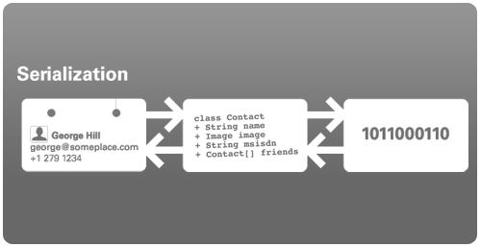
What Is Protobuf?
Protocol buffers are a language-neutral, platform-neutral extensible mechanism for serializing structured data
Google developed it
Like JSON, but binary so smaller/faster
You define how you want your data to be structured once, then you can use special generated source code to easily write and read your structured data to and from a variety of data streams and using a variety of languages.

Slide 9
Protobuf Language Support
Protocol buffers currently support generated code in Java, Python, Objective-C, and C++.
proto3 works with Dart, Go, Ruby, and C#, with more languages to come.
Other 3rd party schema compilers are available to create language-dependent output for over 20 other languages.
Third-party implementations are also available for Ballerina, C, Elixir, Erlang, Haskell, JavaScript, Perl, PHP, R, Rust, Scala, Swift, Julia, and Nim.

Slide 10
What Is It Good For?
Sending data over the wire between internal services
cross-language schema definition for data exchange
Allows you to write several microservices in different languages that can talk to each other via the same schema
You define the schema once and use code generators to generate the interfaces for your language
Protocol Buffers are widely used at Google for storing and interchanging all kinds of structured information. The method serves as a basis for a custom remote procedure call (RPC) system that is used for nearly all inter-machine communication at Google

Slide 11
Advantages Of Protobuf
Guarantees type-safety
Prevents schema-violations
Gives you simple accessors
Fast serialization/deserialization
Easier to bind to objects and faster
Less boilerplate code
Has more data types than JSON, such as enumerates and methods
JSON is not designed for numbers. As JSON is textual, its integers and floats can be slow to encode and decode.
Backwards compatiblity through numbered fields

Slide 12
When To Use JSON
You need or want data to be human readable
For storing data in DB or in filesystems such as S3, JSON should be the obvious choice. This is because it allows you to query these systems without writing additional code using already available tools.
Data from the service is directly consumed by a web browser
Your server side application is written in JavaScript
You aren’t prepared to tie the data model to a schema
You don’t have the bandwidth to add another tool to your arsenal
The operational burden of running a different kind of network service is too great
https://stackoverflow.com/questions/52409579/protocol-buffer-vs-json-when-to-choose-one-over-another

Slide 13
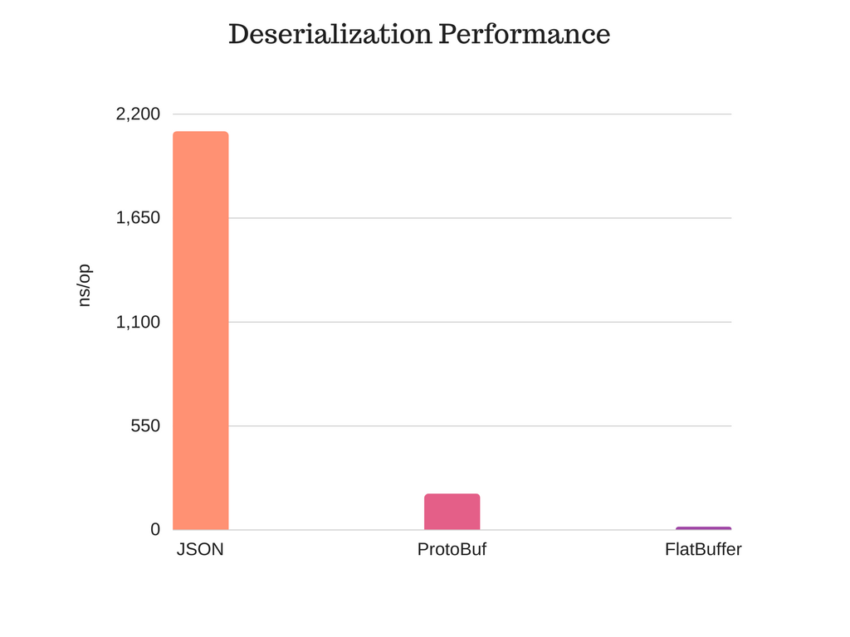
For inter-communications between various REST services or streaming systems (e.g. Kafka) , you should prefer protocol buffers or flat buffers. This is because of the significant difference between the serialization/deserialization performance of these two vs JSON

Slide 14
gRPC As A Migration Path For WCF To .NET Core And .NET 5
.NET Core and .NET 5 marks a shift in the way that Microsoft delivers remote communication solutions to developers who want to deliver services across a range of platforms.
.NET Core and .NET 5 support calling WCF services, but won't offer server-side support for hosting WCF.
Migrating WCF services to use gRPC helps provide the RPC features, performance, an interoperability needed in modern apps.
CoreWCF is a good choice if an app has to maintain compatibility with existing clients that call WCF services.

Slide 15
ASP.NET Core gRPC For WCF Developers
History
TCP/IP became the gold standard for communication between computers.
The development of web services occurred when all major platforms could access the internet, but they still couldn't interact with each other. Web services have open standards and protocols, including:
XML to tag and code data.
Simple Object Access Protocol (SOAP) to transfer data.
Web Services Definition Language (WSDL) to describe and connect web services to client applications.
Universal Description, Discovery, and Integration (UDDI) to make web services discoverable by other services.
gRPC was launched, 10 years after Microsoft first released WCF
01/06/2021
https://docs.microsoft.com/en-us/dotnet/architecture/grpc-for-wcf-developers/

Slide 16
How gRPC Works
WCF uses WSDL to expose metadata about services.
gRPC uses the Interface Definition Language (IDL) from Protocol Buffers.
The Protocol Buffers IDL is a custom, platform-neutral language with an open specification.
Developers author .proto files to describe services, along with their inputs and outputs.
These .proto files can then be used to generate language- or platform-specific stubs for clients and servers, allowing multiple different platforms to communicate.
By sharing .proto files, teams can generate code to use each others' services, without needing to take a code dependency.

Slide 17
Advantages of Protobuf vs. WCF
One of the advantages of the Protobuf IDL is that as a custom language, it enables gRPC to be completely language and platform agnostic, not favoring any technology over another.
The Protobuf IDL is also designed for humans to both read and write, whereas WSDL is intended as a machine-readable/writable format.
Changing the WSDL of a WCF service typically requires changing the service, running the service, and regenerating the WSDL file from the server. By contrast, with a .proto file, changes are simple to apply with a text editor, and automatically flow through the generated code.
Protobuf messages tend to be smaller than the same data serialized as SOAP XML, and encoding, decoding, and transmitting them over a network can be faster.
The potential disadvantage of Protobuf compared to SOAP is that, because the messages aren't readable by humans, additional tooling is required to debug message content.

Slide 18

Features | WCF | gRPC
Objective | Separate business code from networking implementation. | Separate business code from interface definition and networking implementation.
Define services and messages | Service Contract, Operation Contract, and Data Contract. | Uses proto file to declare services and messages.
Language | Contracts written in C# or Visual Basic. | Protocol Buffer language.
Wire format | Configurable, including SOAP/XML, Plain XML, JSON, and .NET Binary. | Protocol Buffer binary format (although it's possible to use other formats).
Interoperability | When using SOAP over HTTP. | Official support: .NET, Java, Python, JavaScript, C/C++, Go, Rust, Ruby, Swift, Dart, PHP. Unofficial support for other languages from the community.
Networking | Configured at runtime. Switch between NetTCP, HTTP, and MSMQ. | HTTP/2, currently over TCP only with ASP.NET Core gRPC.
Approach | Runtime generation of serialization, deserialization, and networking code in base classes. | Build-time generation of serialization, deserialization, and networking code in base classes.
Security | Authentication, WS-Security, message encryption. | Credentials, ASP.NET Core security, TLS networking.

Slide 19
gRPC for .NET
Grpc.Core – Google developed Protobuf for C#
contract-first only
https://github.com/grpc/grpc
Grpc.NET – Microsoft’s version
it uses the same core types as Grpc.Core
it can use the “Kestrel” HTTP/2 server bindings
https://github.com/grpc/grpc-dotnet
Starting from May 2021, Grpc.NET is the recommended implemention of gRPC for C#. (versus Grpc.Core)

Slide 20
protobuf-net.Grpc
[DataContract]
public class MultiplyRequest
{
[DataMember(Order = 1)]
public int X { get; set; }
[DataMember(Order = 2)]
public int Y { get; set; }
}
[DataContract]
public class MultiplyResult
{
[DataMember(Order = 1)]
public int Result { get; set; }
}
protobuf is contract first
protobuf-net.Grpc is code first
Simple gRPC access in .NET Core 3+ and .NET Framework 4.6.1+
https://protobuf-net.github.io/protobuf-net.Grpc/gettingstarted.html

Slide 21
Flatbuffers
Flatbuffers – another Google product
Advantage is that you don’t need to deserialize the whole data before accessing an object.
Better when you have a lot of data and you are concerned with only a snippet of it
Consumes less memory

Slide 22
References
google protocol buffers vs json vs XML
https://codeclimate.com/blog/choose-protocol-buffers/
https://codeburst.io/json-vs-protocol-buffers-vs-flatbuffers-a4247f8bda6f

